Slide 1


Facultad de Computación IIC3641 - GML
Predicting Neural Dynamics in Visual Cortex using a Recurrent Graph Transformer
Nombres:
Jean Rodriguez
Pablo Leiva
Maximiliano Pisfil

Slide 2

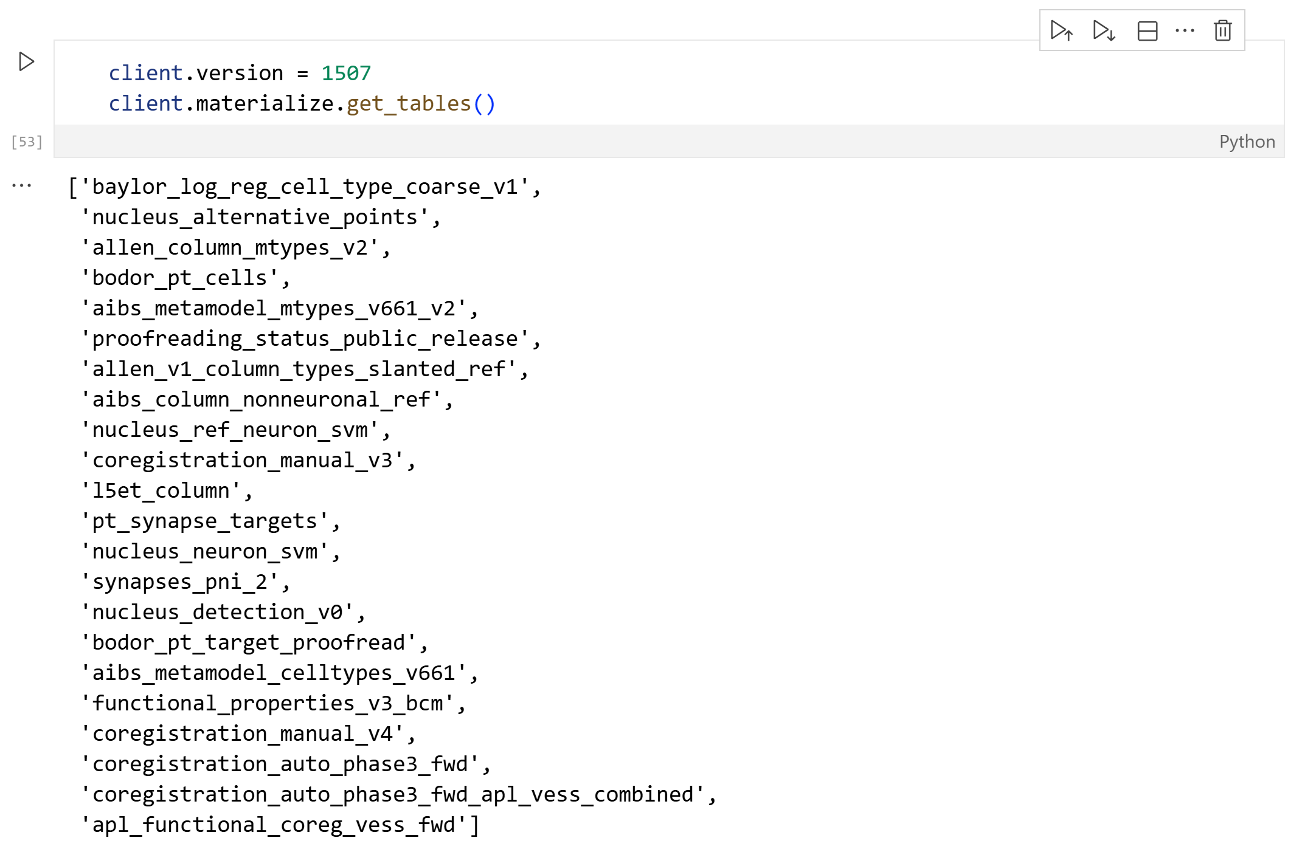

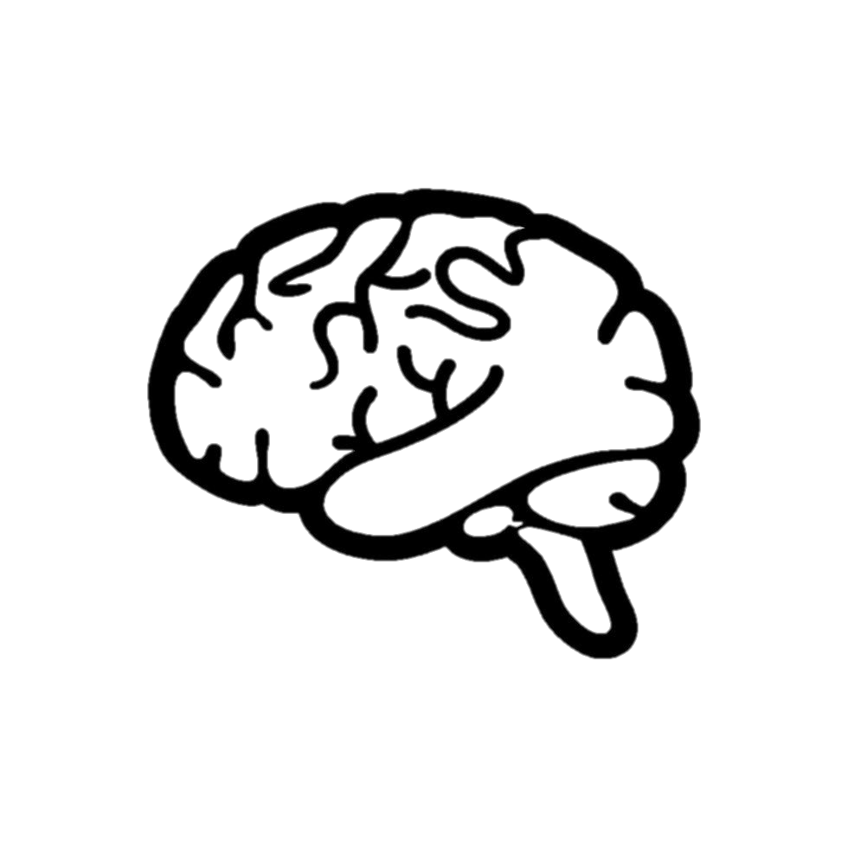

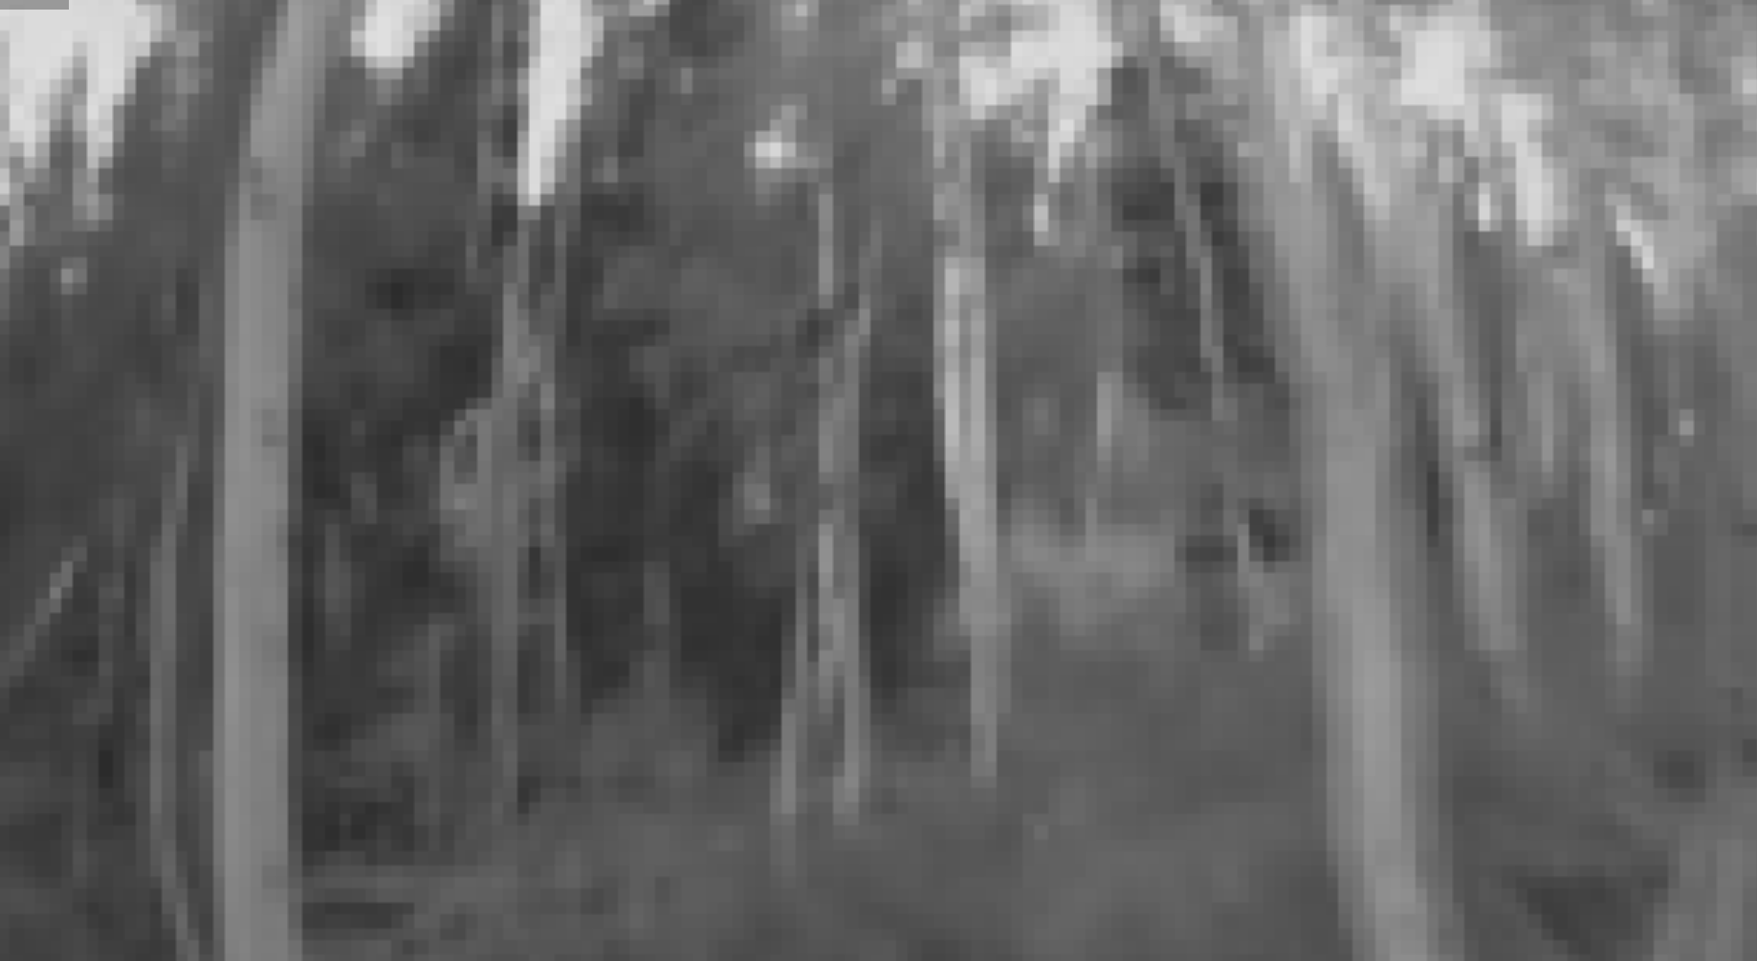
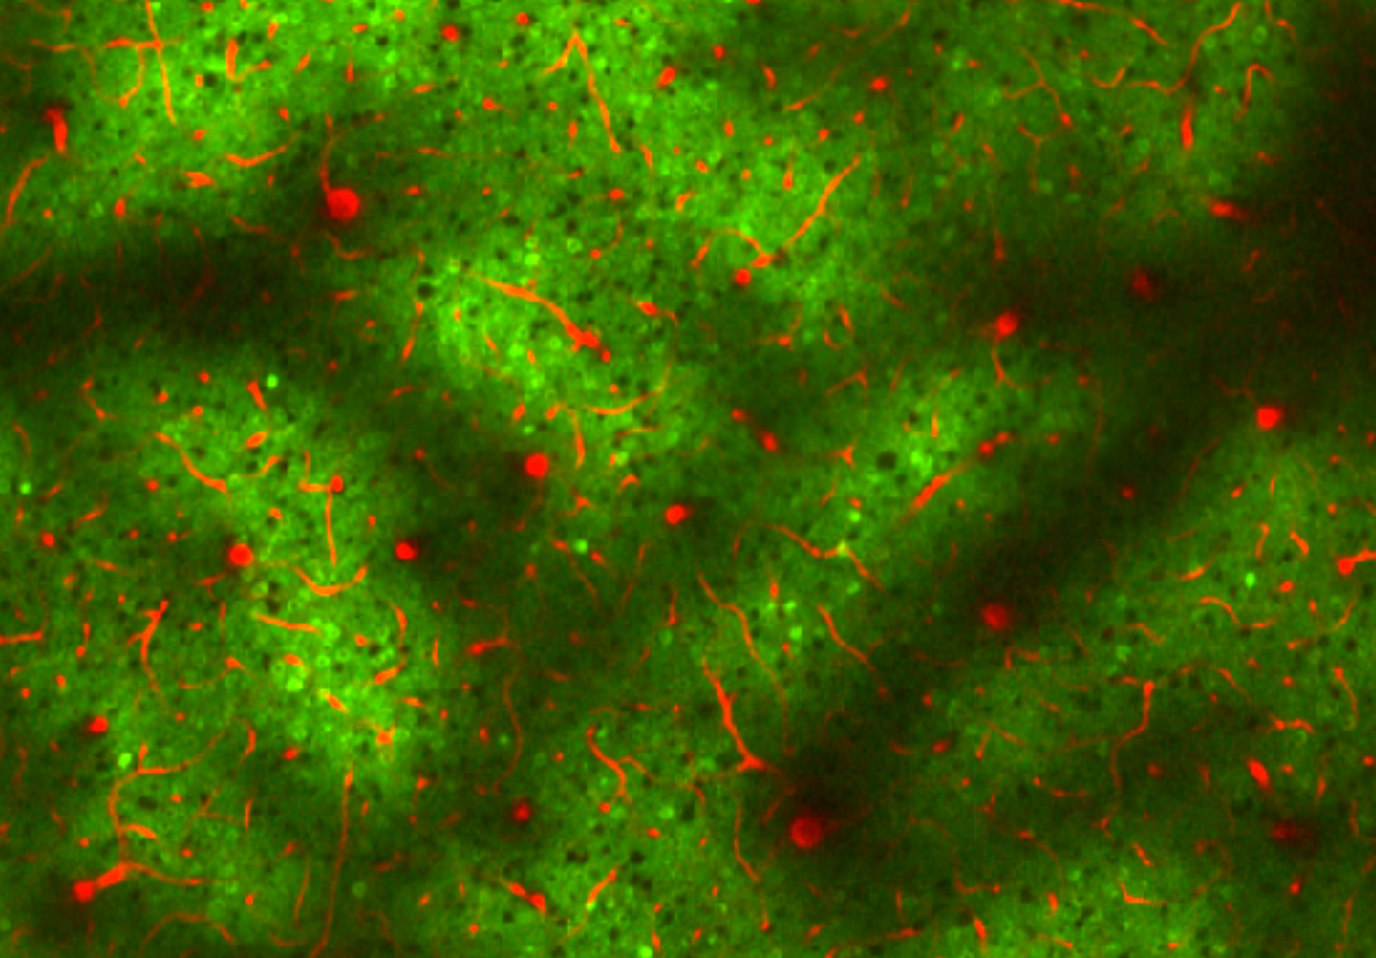
Sobre el dataset escogido
Dataset escogido Microns:
250 x 140 x 90 µm de corteza visual
49.000 tipos de células clasificadas
500.000 Conexiones sinápticas
16 estímulos
19.000 Células registradas en cada sesión
Anatomical Domain
Functional Data
Functional Domain

Slide 3
Anatomical Domain
Functional Data
Functional Domain

Slide 4


Anatomical Domain
Nodes: Types of cells and activation (binary)
Functional Data
Functional Domain

Slide 5
Anatomical Domain
Nodes: Types of cells and activation (binary)
Functional Data
Functional Domain

Slide 6
Anatomical Domain
Nodes: Types of cells and activation (binary)
Functional Data
Functional Domain

Slide 7


Anatomical Domain
Nodes: Types of cells and activation (binary)
Functional Data
Functional Domain
$${ X}_{t}$$
Features
$$E$$
Node embeddings

Slide 8
Anatomical Domain
Nodes: Types of cells and activation (binary)
Functional Data
Functional Domain
$${ X}_{t}$$
Features
Sum
$$E$$
Node embeddings

Slide 9
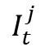
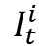
Anatomical Domain
Nodes: Types of cells and activation (binary)
Functional Data
Functional Domain
$${ X}_{t}$$
$$I_{t}^{i}$$
Features
Sum
$$E$$
Node embeddings
$$I_{t}^{j}$$

Slide 10
Anatomical Domain
Nodes: Types of cells and activation (binary)
Functional Data
Functional Domain
$${ X}_{t}$$
$$I_{t}^{i}$$
Positional encoding
Attention
Add&Norm
Features
Sum
$$E$$
Node embeddings
$$I_{t}^{j}$$
Graph Transformer

Slide 11
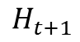
Anatomical Domain
Nodes: Types of cells and activation (binary)
Functional Data
Functional Domain
$${ X}_{t}$$
$$I_{t}^{i}$$
Positional encoding
Attention
Add&Norm
Features
$$H_{t+1}$$
Sum
$$E$$
Node embeddings
$$I_{t}^{j}$$
Graph Transformer

Slide 12
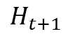
Anatomical Domain
Nodes: Types of cells and activation (binary)
Functional Data
Functional Domain
$${ X}_{t}$$
$$I_{t}^{i}$$
Positional encoding
Attention
Add&Norm
Features
$$H_{t+1}$$
Sum
$$E$$
Node embeddings
$$I_{t}^{j}$$
$$H_{t+1}$$
Graph Transformer

Slide 13
Anatomical Domain
Nodes: Types of cells and activation (binary)
Functional Data
Functional Domain
$${ X}_{t}$$
$$I_{t}^{i}$$
Positional encoding
Attention
Add&Norm
Features
MLP
Sum
$$H_{t+1}$$
$$E$$
Node embeddings
$$I_{t}^{j}$$
$$H_{t+1}$$
Graph Transformer

Slide 14

Anatomical Domain
Nodes: Types of cells and activation (binary)
Functional Data
Functional Domain
$${ X}_{t}$$
$$I_{t}^{i}$$
Positional encoding
Attention
Add&Norm
$${\hat{Y}}_{t}$$
Features
MLP
Sum
$$H_{t+1}$$
$$E$$
Node embeddings
$$I_{t}^{j}$$
$$H_{t+1}$$
Graph Transformer

Slide 15
Anatomical Domain
Nodes: Types of cells and activation (binary)
Functional Data
Functional Domain
$${ X}_{t}$$
$$I_{t}^{i}$$
Positional encoding
Attention
Add&Norm
$${\hat{Y}}_{t}$$
Features
MLP
Sum
$$H_{t+1}$$
$$E$$
Node embeddings
$$I_{t}^{j}$$
$$H_{t+1}$$
Graph Transformer

Slide 16
Plan de actividades: Avance y Entrega Final
Avance
Dataset depurado con la información a entrenar el modelo.
Entrenar las sesiones en frames para trabajarlas a features del modelo.
Arquitectura de Graph Transformer Recurrente con respaldo teórico de cada parte.
Entrega Final
Graph Transformer Recurrente funcionando.
Se logra predecir la respuesta del grafo ante estímulos.

Slide 18
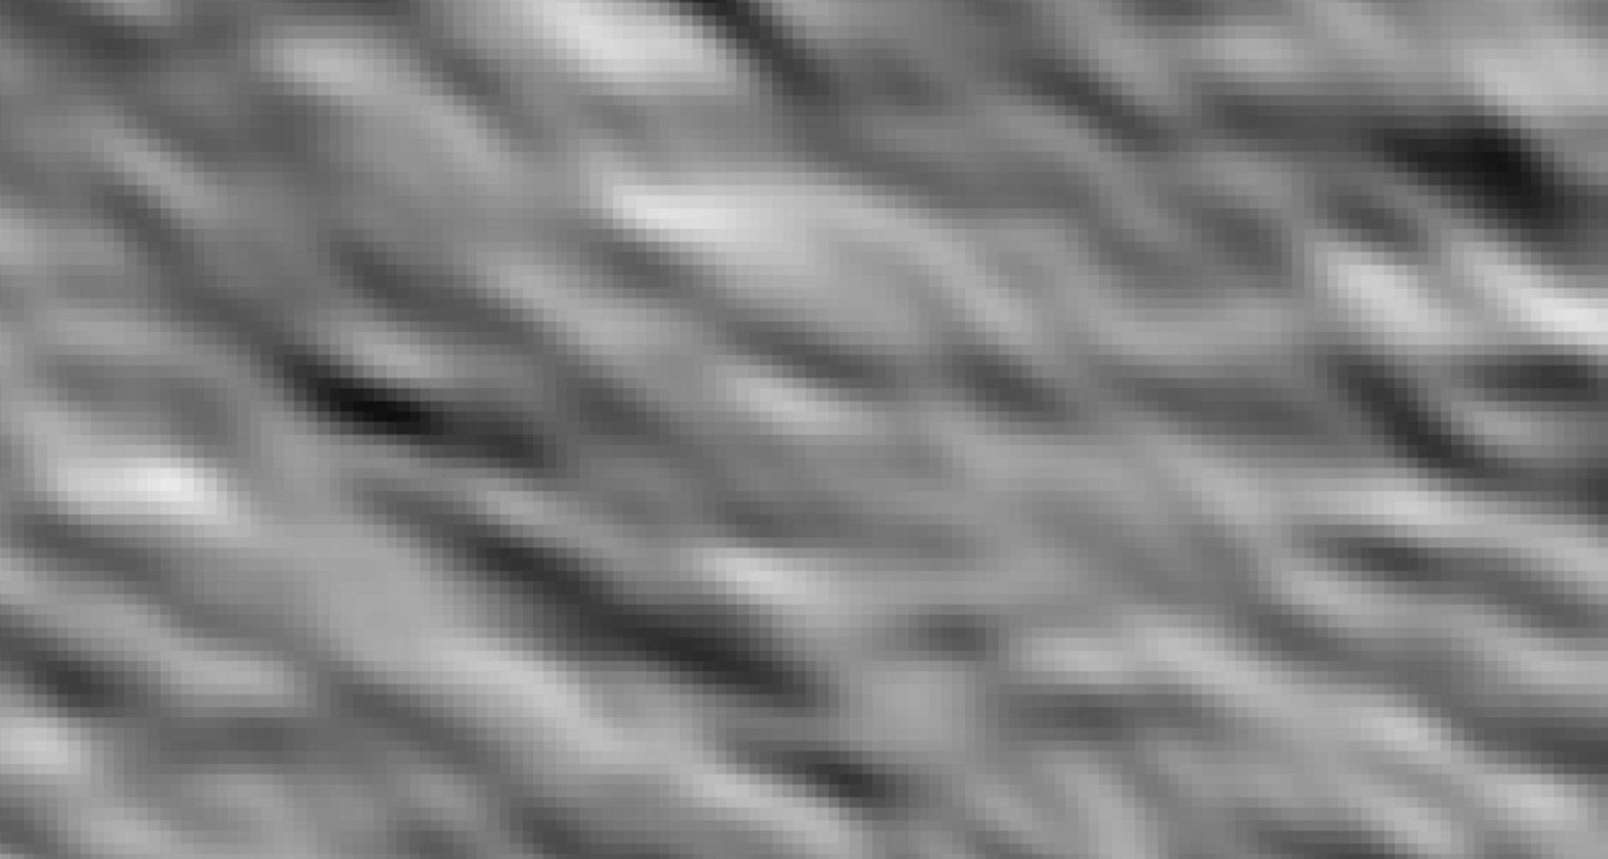
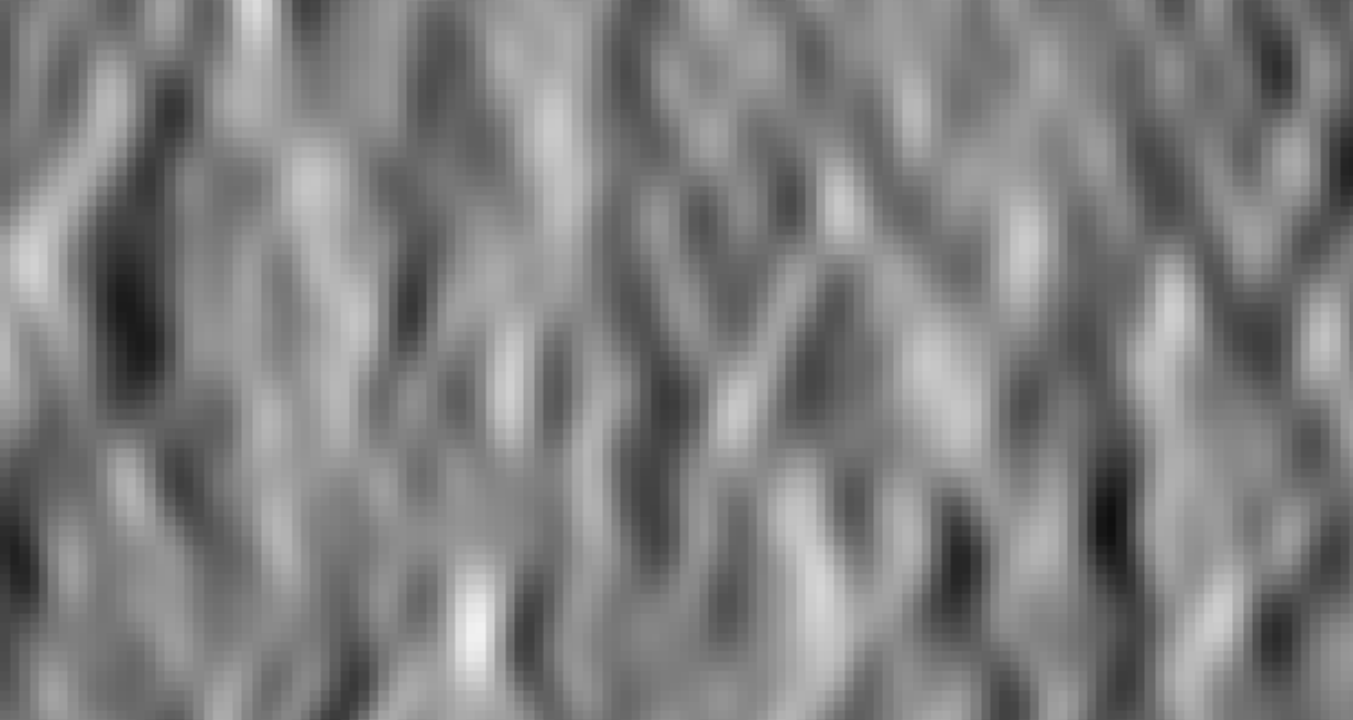
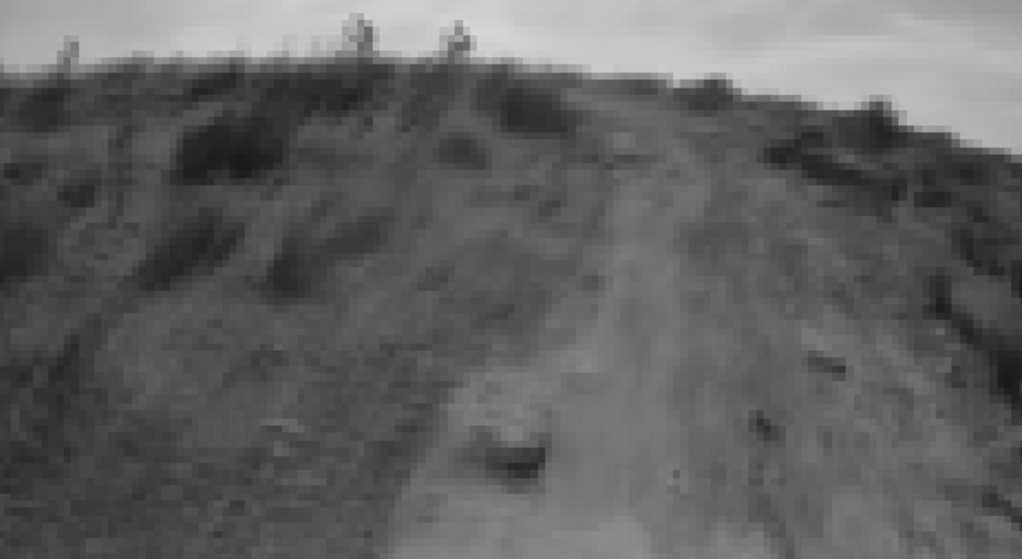
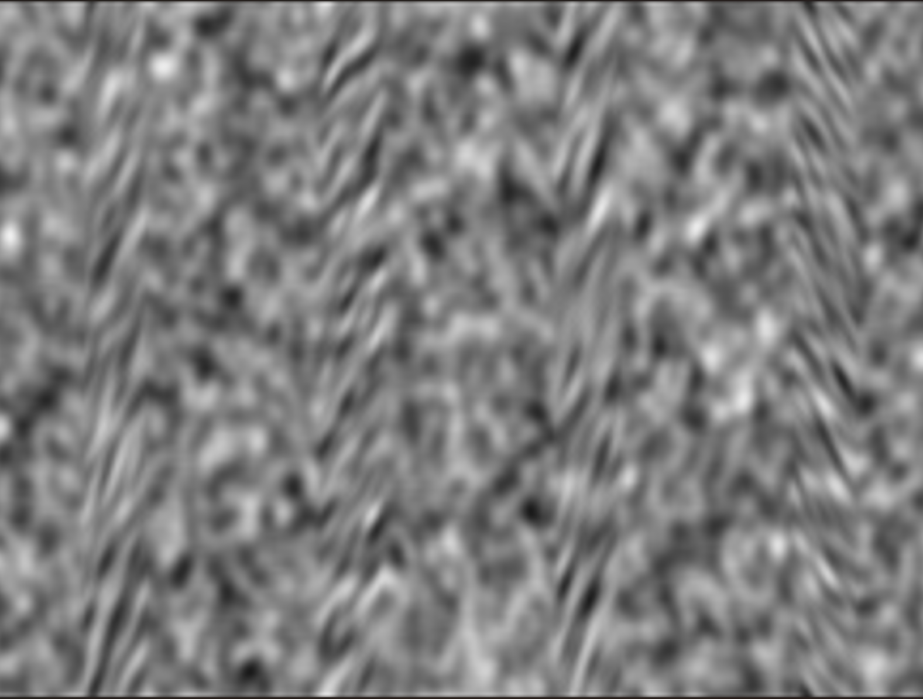

Slide 19
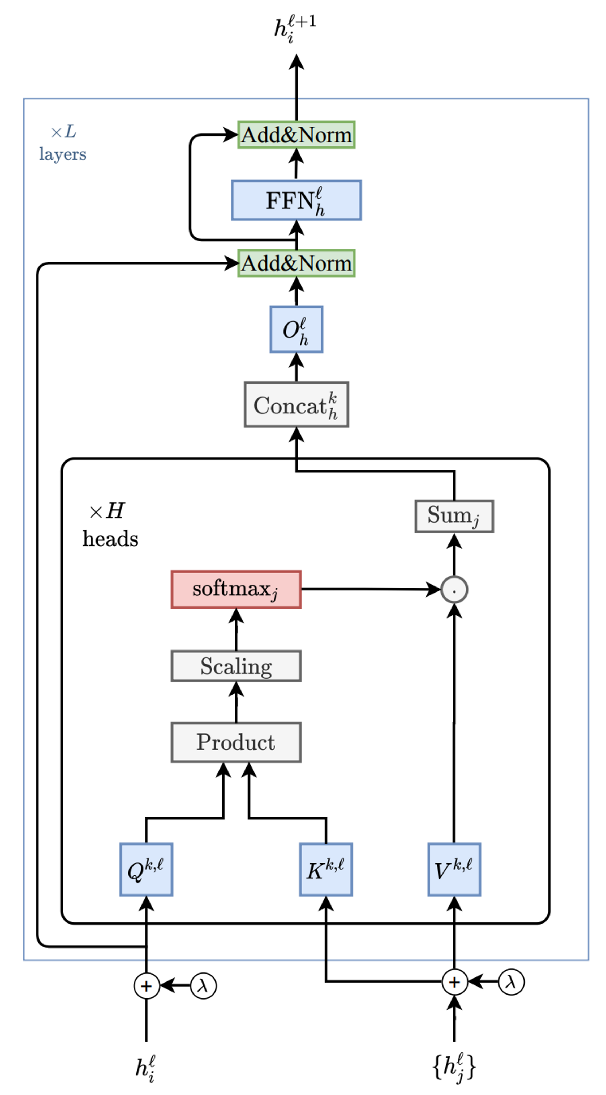









$$λ$$
$$Q$$
\dot
$${ X}_{t}$$
$$K$$
$$λ$$
$$V$$
$${\hat{Y}}_{t}$$
Features
$$H^{0}$$
Node embeddings
$$E^{0}$$
Edge embeddings
Add&Norm
Positional encoding
Attention

